Slide 1



A Platform Architecture for Sensor Data Processing and Verification in Buildings
Software Defined Buildings
Jorge Ortiz
University of California Berkeley
http://www.cs.berkeley.edu/~jortiz

Slide 2
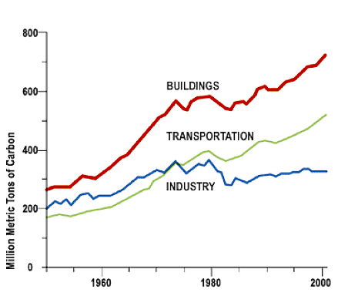
Buildings As Prime Target
Buildings
72% of electrical consumption
40-50% of total consumption
42% of GHG footprint
US commercial building consumption doubled 1980-2000, 1.5x more by 2025 [NREL]
4.8 M Commercial & 350,000 industrial buildings
Renewable energy consumption
Represent wider body of computational and information
challenges of complex physical systems
Notes:
Energy → buildings consume lots → waste lots
Buidlings are complex systems -> not well understood → need sensing
Building important as instance of a wider body of challenges in computational and information aspect of complex physical systems
http://www.energystar.gov/ia/business/challenge/learn_more/FastFacts.pdf
Obama announcement on green energy
Too much text
To fast for a “general” audience
Build out the entity-relationships or something
Simple example about a system
Too much detail about the implication of it being a FS → really fast
Emphasize the more here: Why is that the file answer?
I didn’t explain what the hell EMD was. Why is EMD a good fit here? Same for the FS part.
Problem setup vs solution → make sure you divide those two.
Motivating it as a cool problem
Tautological → Why did you do this? How well did this work?
I never asked a question.
Relationships! Relationships! Relationships!
What would be the programming abstraction for the building? What if on that.
Deeper than lesson learned.
What are the questions? How do they fall out here?
FS → ERG
Automate the generation of the ERG or not.
Where did you save energy? If energy is so important, show me that you fixed that.
Where else might this apply? Get them to answer the question.
EMD/EMF stuff → don’t sound like you didn’t know what you were talking about.
High correlation b/w it and that → remaining stuff didn’t work.
What is simultaneous heating and cooling?
Draw this out more, more, more.
Don’t just do this as a one-off!
How do you create an entity? You point at it! How do you create a relationship? Swipe!
What are some of the problems in the buildings, to begin with.
Make sure that if they don’t give a damn about buildings that you could still

Slide 3
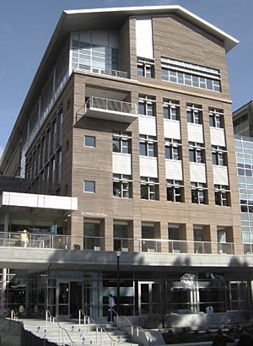



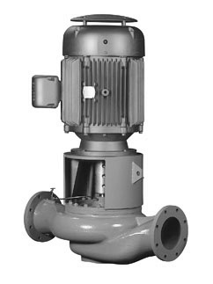

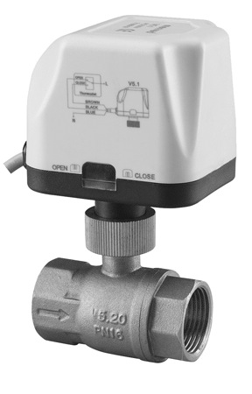
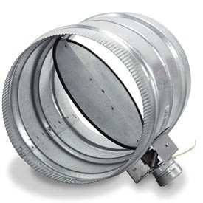
Huge Sensor Networks
151 Temperature Sensors
312 Light Relays
> 6,000 Sense and Control Points
50 Electrical Sub-meters
6 Variable Speed Pumps
12 Variable Speed Fans
121 Controllable Valves
138 Air Dampers
Sutardja Dai Hall
Built in 2009
140k sq. ft.
Notes:
Most buildings contains many sensors and more and more are being added
Sensing used to understand systems and activity → maintain healthy and efficient
Hard to manage → need an OS!
They already contain a huge sensors network and more sensors will be added in order to get to
Continue to figure out how to make them more energy efficient.
Retrofits and sub-meters are constantly being added to new and old buildings.
Integration of the building with the grid, etc.
===================
> Add a lot of backup slides
Too many tables about streamfs
Too big a jump from slide to slide in the beginning.
Why is it a FS is providing the namespace? These things are not files at all.
Lead to evals.
What is a file system today. A way or organizing
What the same and what’s different?
Objects are only sometimes teased together? Look at HDFS.
How about Dropbox?
Underneath somebody’s words that you could tease out an engage.
* Collections of resources accessible through a common namespace.
How do you do garbage collection?
Should this be FS like? Or DB like?

Slide 4
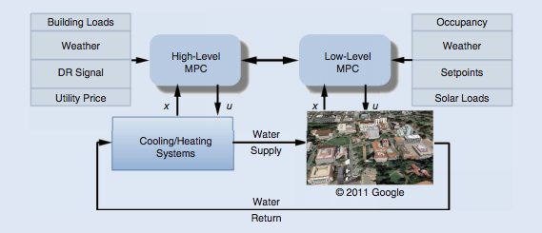
Holistic Building Optimization
[1]
Aggregate load decisions trickle down
Local control based on local conditions
[1] Yudong Ma; Kelman, A.; Daly, A.; Borrelli, F., "Predictive Control for Energy Efficient Buildings with Thermal Storage: Modeling, Stimulation, and Experiments," Control Systems, IEEE , vol.32, no.1, pp.44,64, Feb. 2012
Notes:
FIGURE 19 Hierarchical model predictive control (MPC) structure for a building control system. A high-level MPC (HMPC) is deployed to
optimize the operation and schedule the cooling and heating systems with active thermal storage. A low-level MPC (LMPC) controls the
variable air volume boxes and the air handling units by considering thermal comfort constraints of the occupants. At both levels a variety
of predictions can be included in the models and in the cost function to control the system in an efficient and effective way. These predictions include building loads, load shedding signals from the power grid, utility prices, weather, occupancy, and solar loads
Yudong Ma; Kelman, A.; Daly, A.; Borrelli, F., "Predictive Control for Energy Efficient Buildings with Thermal Storage: Modeling, Stimulation, and Experiments," Control Systems, IEEE , vol.32, no.1, pp.44,64, Feb. 2012

Slide 5
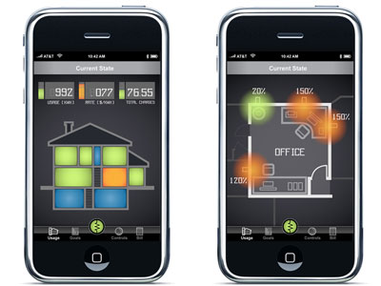
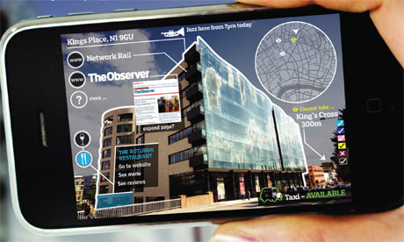
Diagnostics and Control with Mobiles Phones

Slide 6
We need to manage building sensors and actuators in a unified fashion

Slide 7
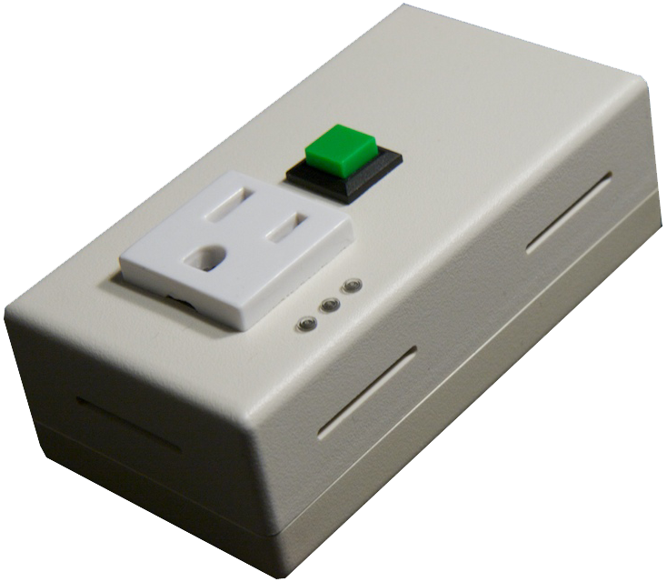
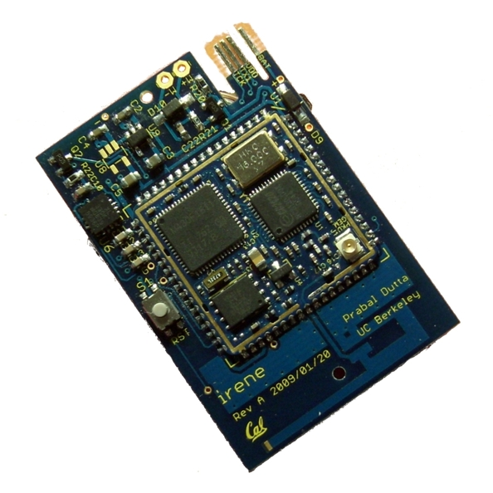
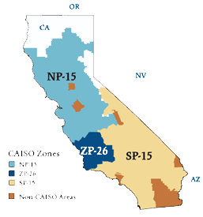
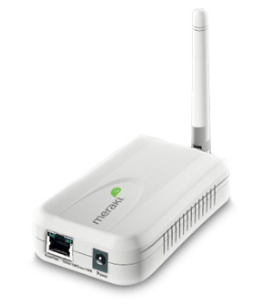
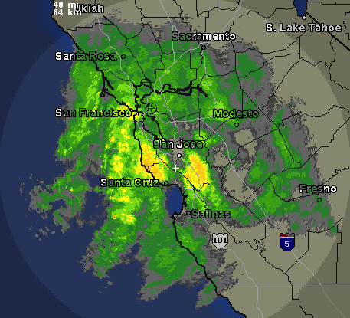
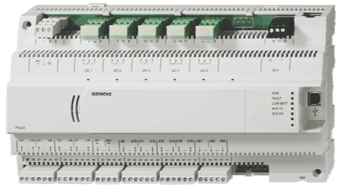

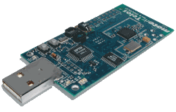
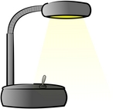


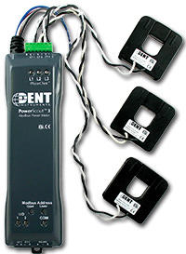
Why is this challenging?
EBHTTP / IPv6 / 6LowPAN Wireless Mesh Network
Sensors,
Actuators
Controllers
AC plug meter
Vibration / Humidity
California ISO
Edge Router
Internet
Siemens P2
over RS-485
Remote
Login
Light switch
Temperature/PAR/TSR
Apogee
Server
BACnet/IP
Dent circuit meter
Modem
Protocol | Year | Network | Example Applications
Modbus | 1979 | RS-485, TCP/IP | Panel monitoring, alarms
Fieldbus/HART | 1988 | various | Industrial Control
BACnet | 1995 | ARCNET, Ethernet, IP, RS-232, etc. | HVAC, Lighting, Fire…
WirelessHART | 2007 | 802.15.4e | Industrial control, wire replacement
Zigbee SEP 2.0 | 2011? | 802.15.4 | Plug-load monitoring
Notes:
(pictures) Sensors use different standards/interfaces (Bacnet, Lontalk) for communicating with them, are part of separate silos (bms for hvac, lighting system, security system)
Forces analysis to be done locally
Because buildings aren't standardized, innovative solutions are not portable

Slide 8
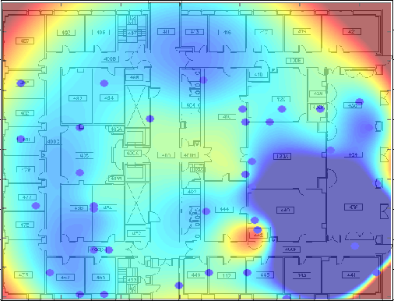
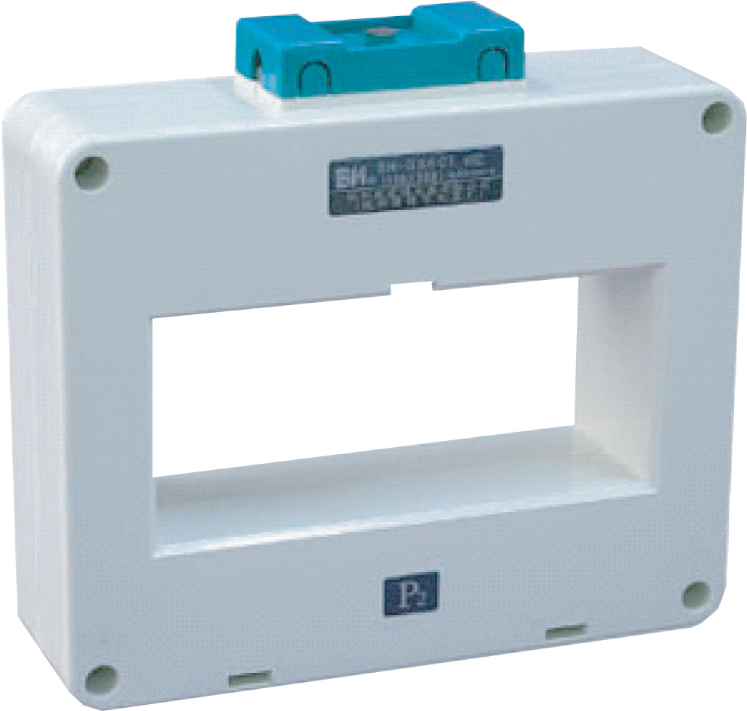
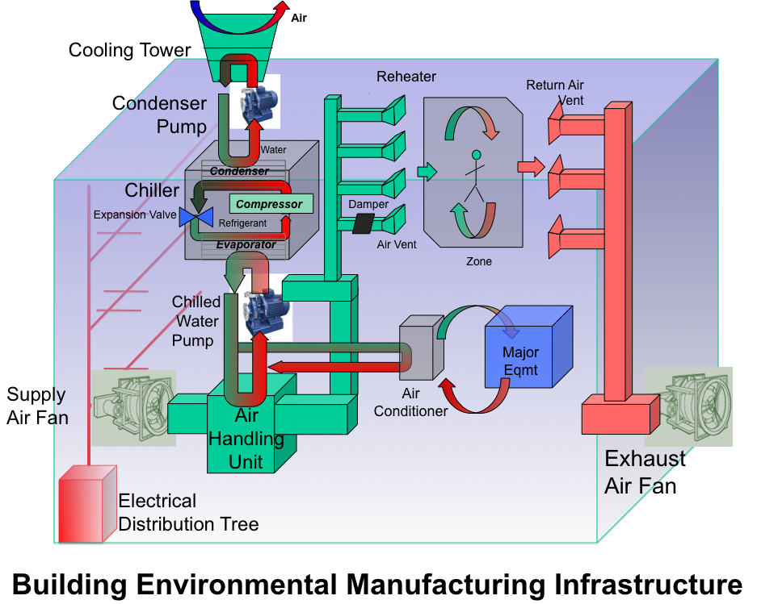
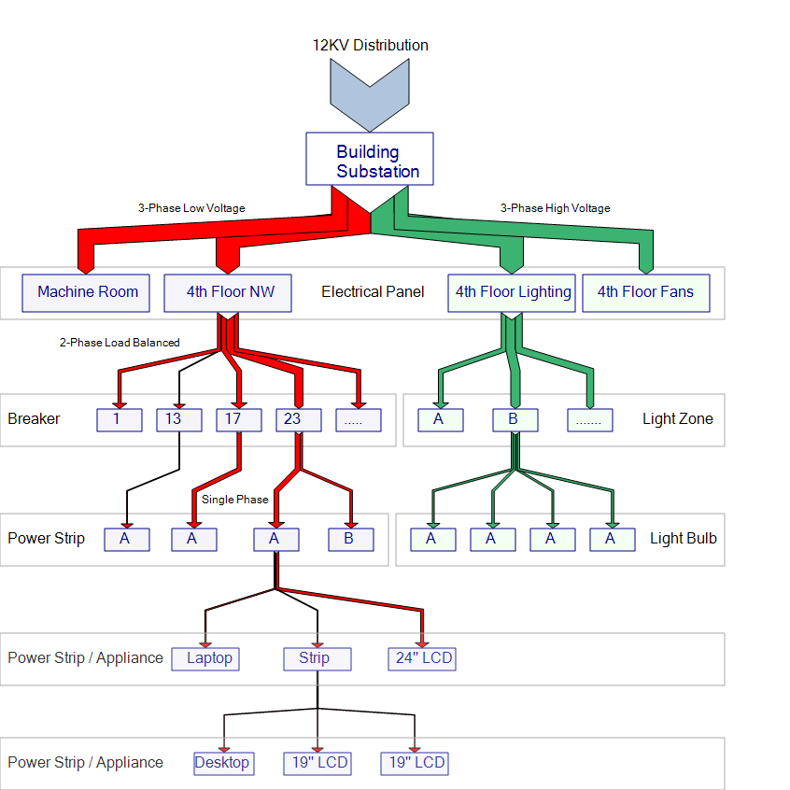
Why is this challenging?
Operations and Environment
Climate Plant
Electric Load Tree
CT: mains power monitoring
panel level power monitoring
Vibration
Humidity
Temperature
Pressure
ACme: plug load energy monitor and controller

Slide 9
Complications
Thousands of sensors in separate silos
No holistic view, information sharing or extensibility
Many legacy/emerging standards and interfaces
No integration, portability, scale
Buildings are living entities, constantly evolving
Difficult to manage

Slide 10
Solutions
Systemic view through OS Abstractions
Focus on filesystem abstraction, data services
Continuous verification of physical relationships
Office re-arranged, walls moved

Slide 11
Solutions
Systemic view through OS Abstractions
Focus on filesystem abstraction, data services
Continuous verification of physical relationships
Office re-arranged, walls moved

Slide 12
Sensors/Actuators As Resources
Data producing, data consuming
Uniquely identifiable
User-driven multi-categorization
Direct, uniform access
Notes:
Sensors can be abstractly represented as resources – some data generating some data
consuming.
Applications require access to these over a uniform namespace. A system is required to
manage both access and naming.

Slide 13

Where have we seen this before?
root
dir1
file1
file2
dir2
file3
Unix filesystems!
Resource exposed via namespace
FS controls access to resources and collections
Notes:
Files represent a logical collection of bytes
A filesystem provides a common namespace for these collection
via a unified namespace
the filesystem also controls access to resources through user accounts
and resource-based permissions

Slide 14
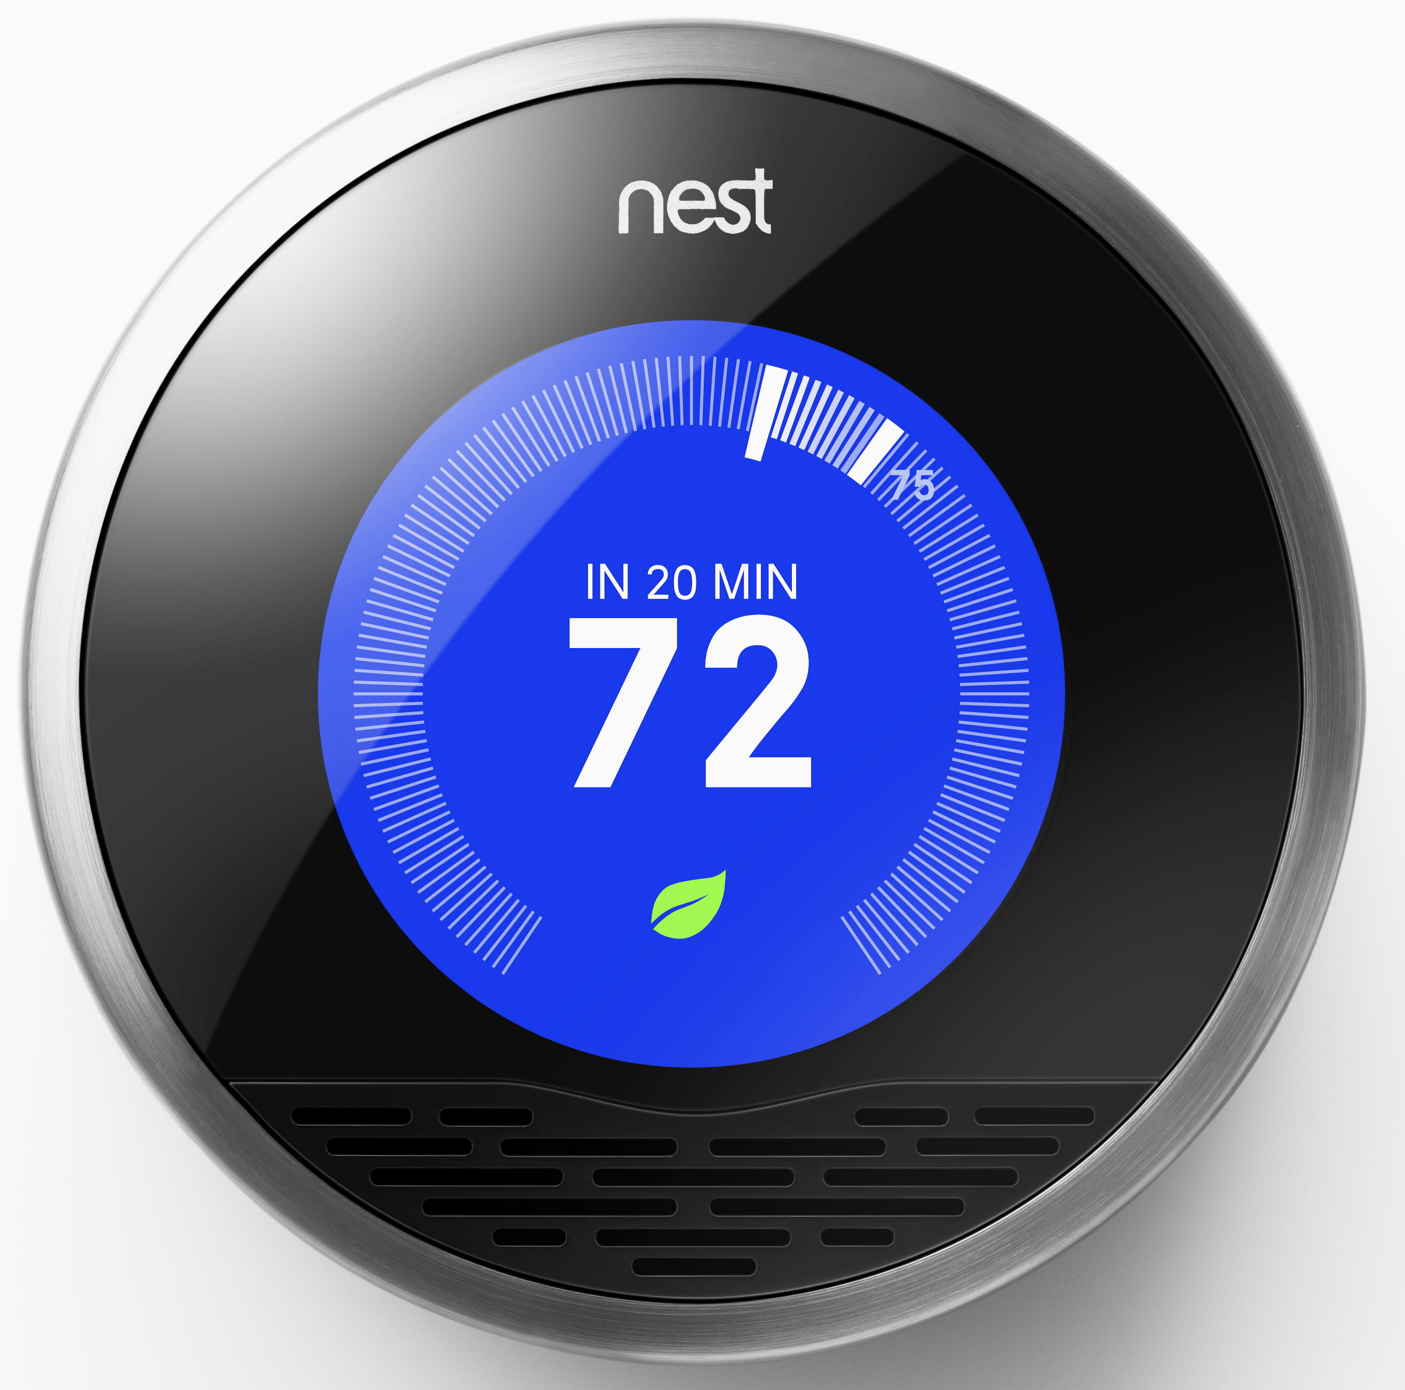
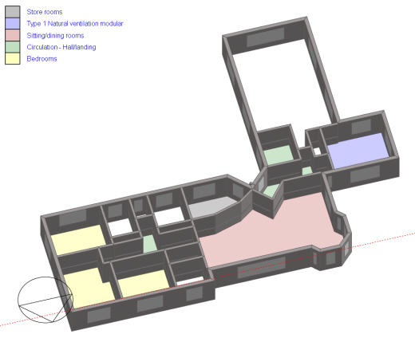
Sensors as Files
uid:d73a3040e095
temp
owner:jorge
installed:06/28/10
/room/410/temp
/room/420/temp
*
*
*
Notes:
(pictures) walk through an example for representing a thermostat in a room, as a file
inode analog
show the thermostat
give the thermostat a name
give it an identifier
show how attribute-value pairs are added
add the room around the thermostat
add the rest of the path to the name to show context

Slide 15
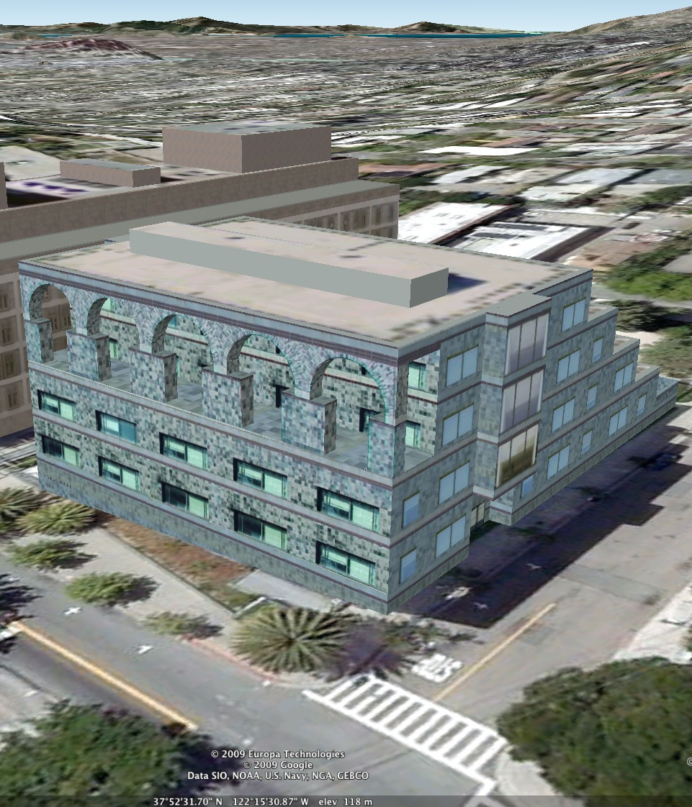
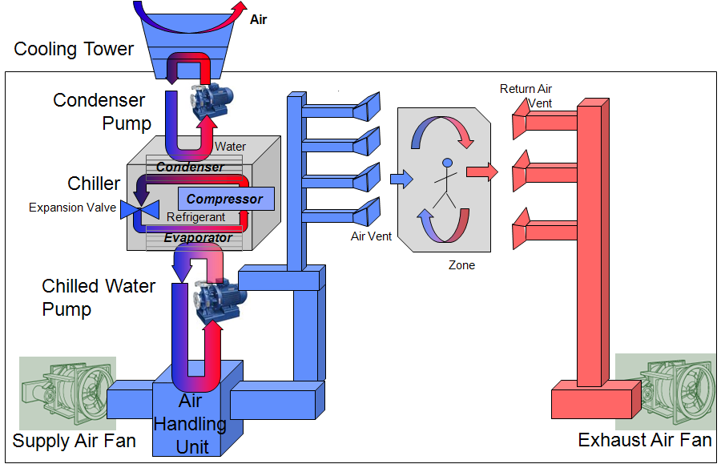
Views Captured in Namespace
Environment and Activity
/spaces
/floor3
/floor4
Multiple
building
views
Common
Namespace
/SodaHall
/hvac
/loadtree
/CT
/Chiller
/panel
/xform
Climate plant
Electrical Load Tree
Notes:
Organizing principle:
Everything looks like a file
Inherit symbolic links, piping, grep, other tools
Inherit security model
Each file is taggable with semi-structured data (for fast search)
Most other things are folders

Slide 16
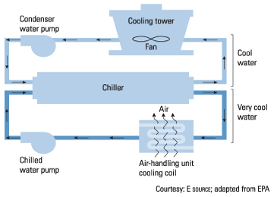
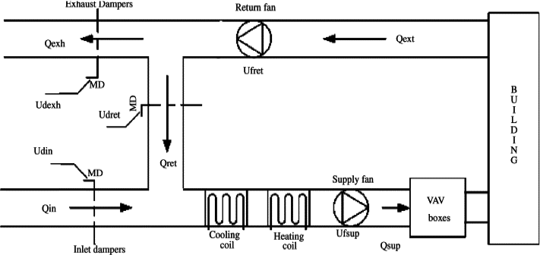
Capturing Inter-relationships
/vav/zone/room/410/return/exchanger
/exchanger/hcoil
/hcoil/heater/pump
/pump/hcoil
Notes:
With symbolic links, we can capture more complex relationships

Slide 17

Implementation
~20k lines of code (Java)
4 core components
Web service architecture

Slide 18
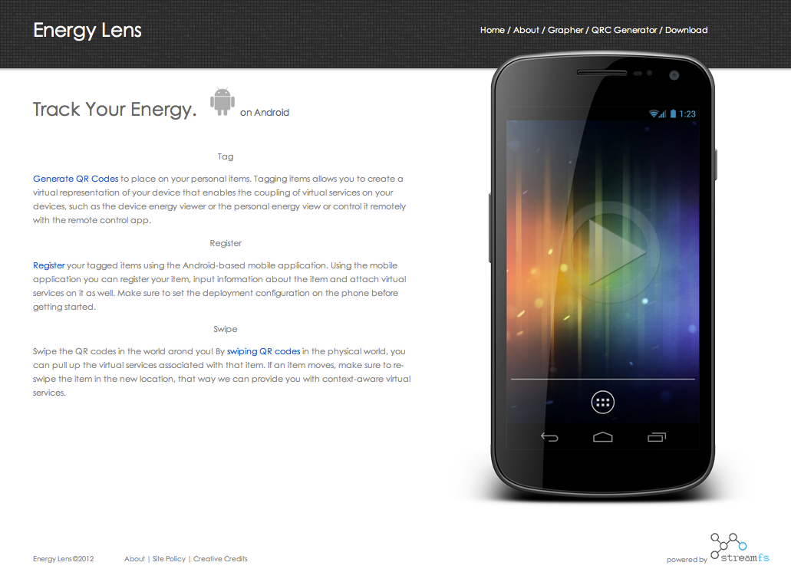
Application: The Mobile Energy Lens
Notes:
What relationships are important to capture?
Location
Meter-to-load relationship (…over time)
Tag everything
Use phone to input information about things…
Classification, location, type, etc.
…and the relationship between things

Slide 19
Energy Lens Challenges
Tracking people and things
Active Aggregate Statistics
Consistency Management
Disconnect Operation

Slide 20
File Abstraction
4 Types
container, stream, ctrl, special
Canonical container names
/dev/ctrl
/dev/strm
/proc

Slide 21
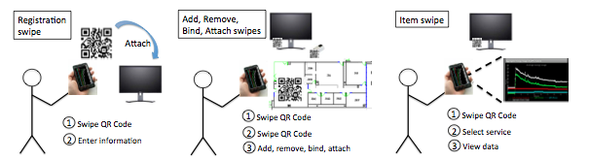
Swipes Capture Links
/qrc
/inventory
/spaces
/inventory
Update entity-relationships
{“type”:”item”}
{“type”:”qr_code”}
{“type”:”item”}
{“type”:”meter”}
{“type”:”meter”}
{“type”:”meter”}
{“type”:”stream”}

Slide 22
Stream Resampling
2
Stream
1
Time
{
"operation":”create_process",
"name":”loadcurve",
"script":{
"winsize":12,
"materialize":true,
“timeout”:T,
"func":"function(buffer, state){
...
}"
}
}
T
Value
s₃(t_{i})=sum(s₁(t_{i}), s₂(t_{i}),…)
Time

Slide 23
Process Management Through FS
/proc/loadcurve/
/proc/loadcurve/eda76b7a3b23/
{
"status": "success",
"type": "PROCESS_CODE",
"properties": {
"operation": "save_proc",
"name": "slope_intercept_tester",
"script": {
"winsize": 10,
"materialize": "true",
"timeout": 80000,
"func": ”
function(buffer, state){
. . .
loadcurve.push({'ts':cleaned [thissubid][ts_idx].ts,
'value':sum});
. . .
outObj.data = loadcurve;
return outObj;
} "
}
},
"children": [
"eda76b7a3b23"
]
}
{
"status": "success",
"pubid": "85e23cce-2378-4c85-9395-09be857e40ff",
"head": {
"value": 3271.6666672825813,
"ts": 1345573470
},
"properties": {}
}
/sub/1b524cb/
{
"status": "success",
"pubid": "85e23cce-2378-4c85-9395-09be857e40ff",
"head": {
"value": 3271.6666672825813,
"ts": 1345573470
},
"properties": {}
}

Slide 24
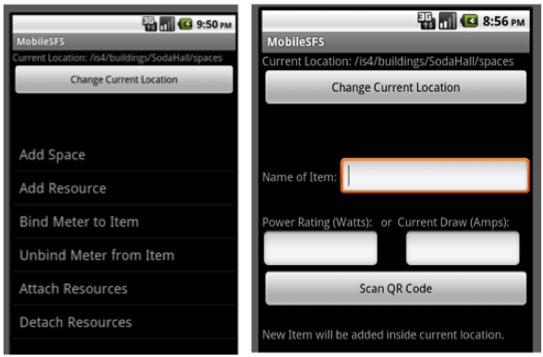
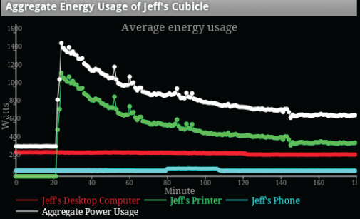
Collection & Live Aggregation

Slide 25
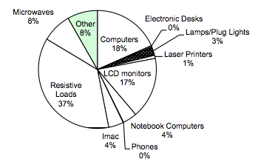
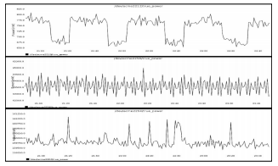
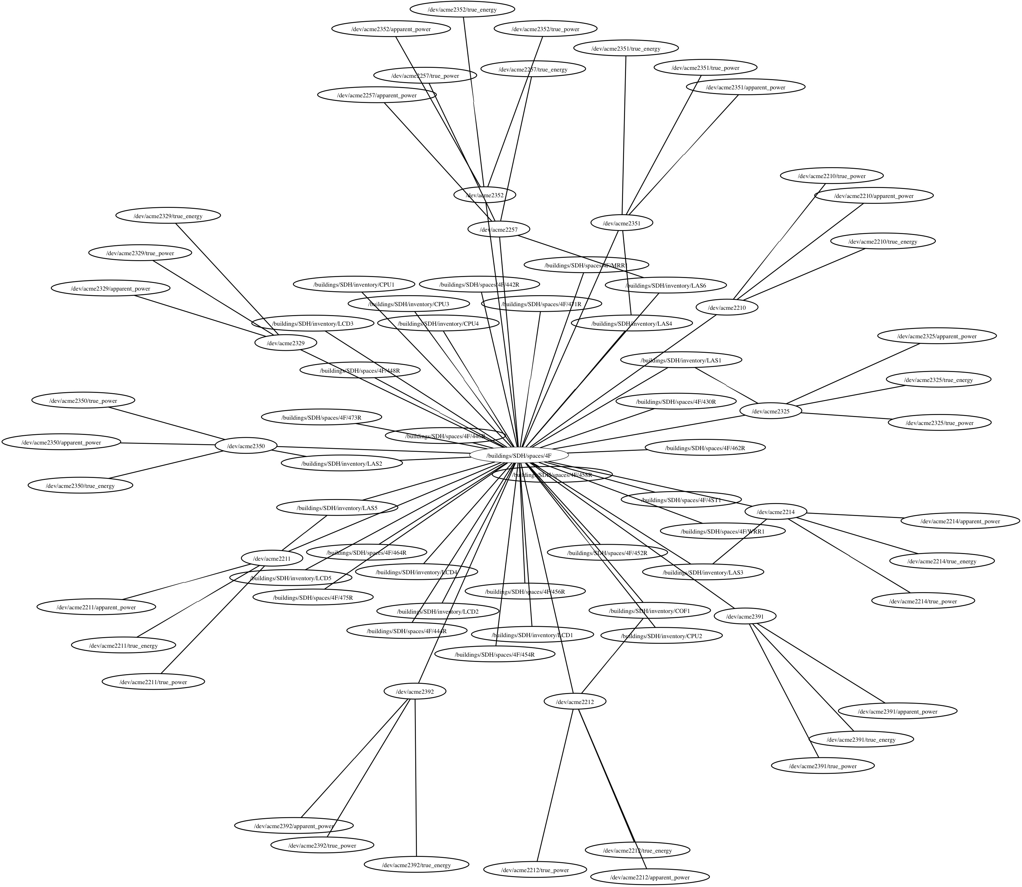
Live Statistics On Building Inventory
SDH deployment
Registered and classified
20 meters
371 loads
139 rooms
7 floors

Slide 26
Solutions
Systemic view through OS Abstractions
Focus on driver interface, filesystem abstraction
Continuous verification of physical relationships
Office re-arranged, walls moved

Slide 27
Verification
Inter-relationships manually specified
Geometric Relationship: relative spatial associations
temp1
temp2
pow1
pow2
/spaces
/floor3
/floor4
Can we use the sensor data to determine
geometric relationships?

Slide 28
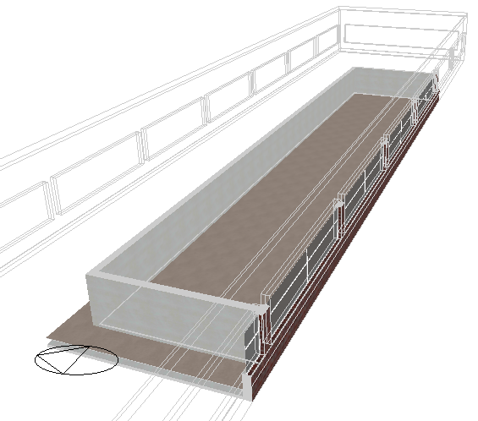
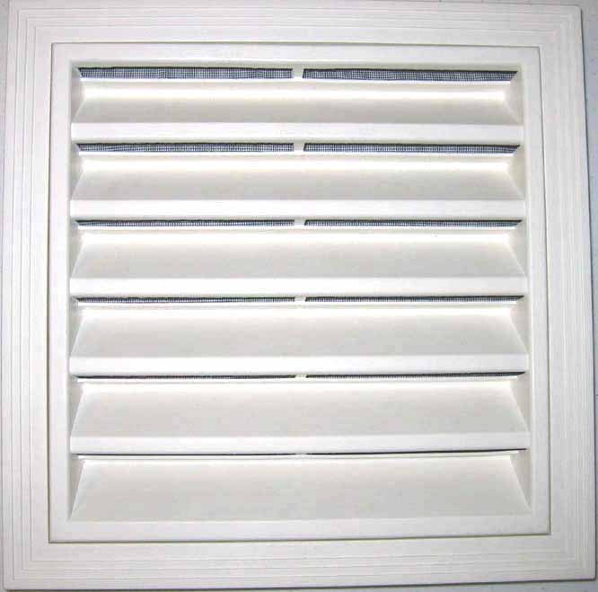
Models Depend on Geometry
L total load
C*ΔT = u + P_{d} + (T_{oa} – T)/R
C thermal capacitance
T temperature in the space
u heating/cooling power input
P_{d} occupant/computer load
T_{oa} outside air temperature
R is the resistivity of the walls
* * *
V_{t} vents served
New space added
V_{s} changes per space
V_{s} vents in
space
Mapping vents to zones/spaces
must be accurate
How can we automatically discover
changes made to the physical layout?
Notes:
C*ΔT = u + P_{d} + (T_{oa} – T)/R
C is the thermal capacitance
T is the temperature in the space
u is the amount of heating/cooling power input
U>0 (heating)
U<0 (cooling)
P_{d} is the external disturbance load generated by occupants, direct sunlight, and electrical devices
T_{oa} is the outside air temperature (outside the immediate space, adjacent to the walls)
R is the resistivity of the walls for that space
Typical MPC based on this model
Minimize total heating and cooling energy consumption
Minimize peak power draw
Maintain zones within desired comfort range (despite predicted changes in load)
We know the heating and cooling sensors (on off/state, and the size of the equipment)
We input the zones it feeds through the vents
So we can approximate the input load to the a fraction of the output – a loss constant
u=V_{s}/V_{t} * L – ε_{L}
How many vents are fed by the HVAC system from the central HVAC system?
What fraction of them on in the space?
What’s the current load output of the system? Is it heating or cooling? (L>0 heating, L<0 cooling)
What happens if the space changes?

Slide 29
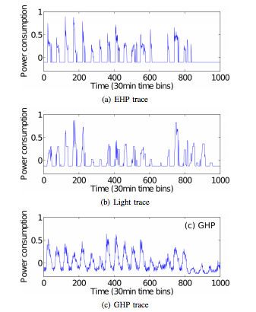
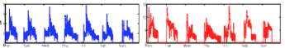
Similar Trend in Data Streams
Sensor streams driven by same phenomena
Common trend ineffective at uncovering relationships

Slide 30
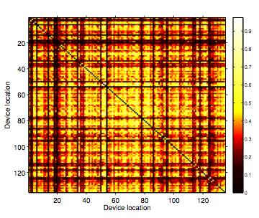
No Discernible Correlation Pattern in Raw Traces
Each row/column is a location in the building
Each location has one or more sensors
Cell (i,j) is the average device pairwise correlation between sensors at locations i and j

Slide 31
An example…
Applying EMD on a temperature trace
“High” Frequency
“Medium” Frequency
“Low” Frequency
Notes:
A temperature trace from some room in a week
EMD breaks up the signal and show underlying mode, for example, the “low” frequency component reflects the dominant diurnal pattern in the original signal

Slide 32
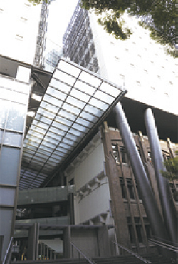
Experimental Setting
University of Tokyo
Engineering building 2
12-story building
Built in 2005
>600 sensor stream dataset
Lighting and HVAC for 231 rooms
10 weeks of summer 2011
Post-Fukushima Daiichi nuclear disaster

Slide 33
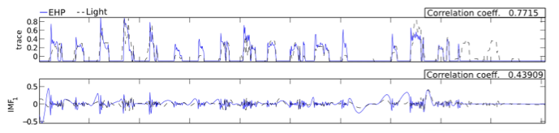

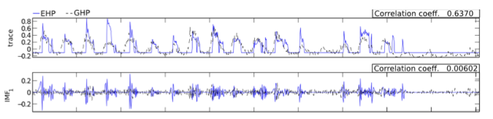
Analysis with EMD
Same room
Different rooms

Slide 34
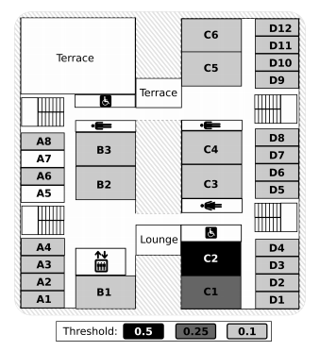
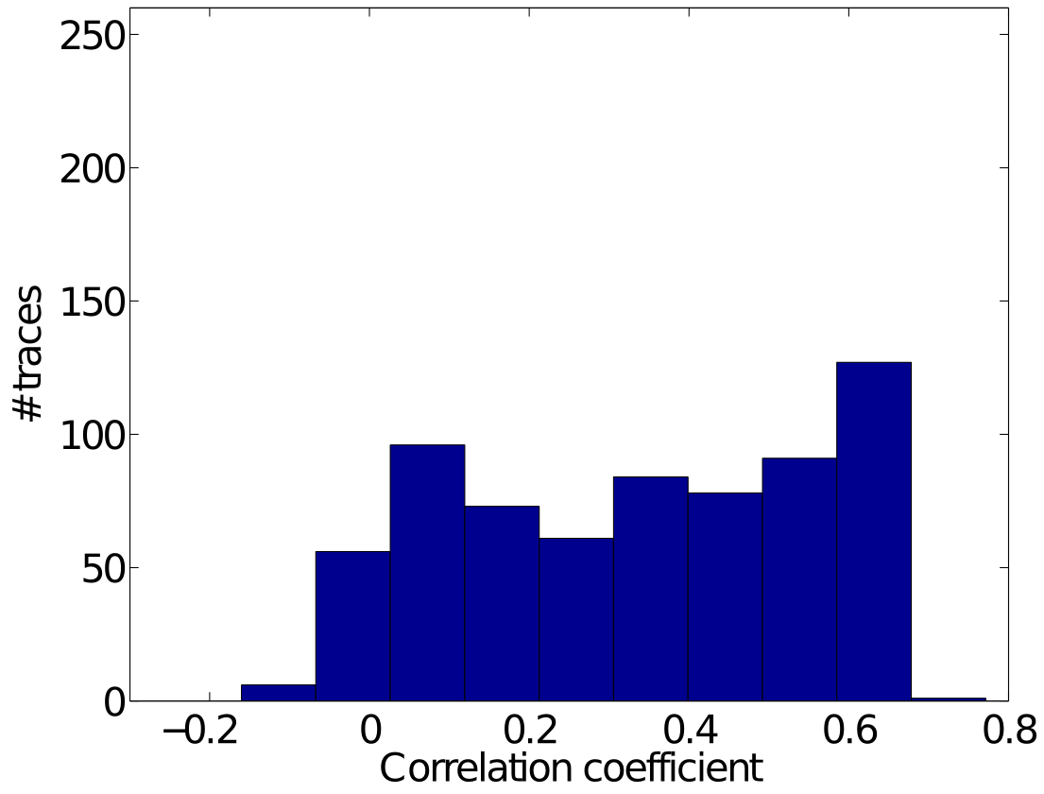
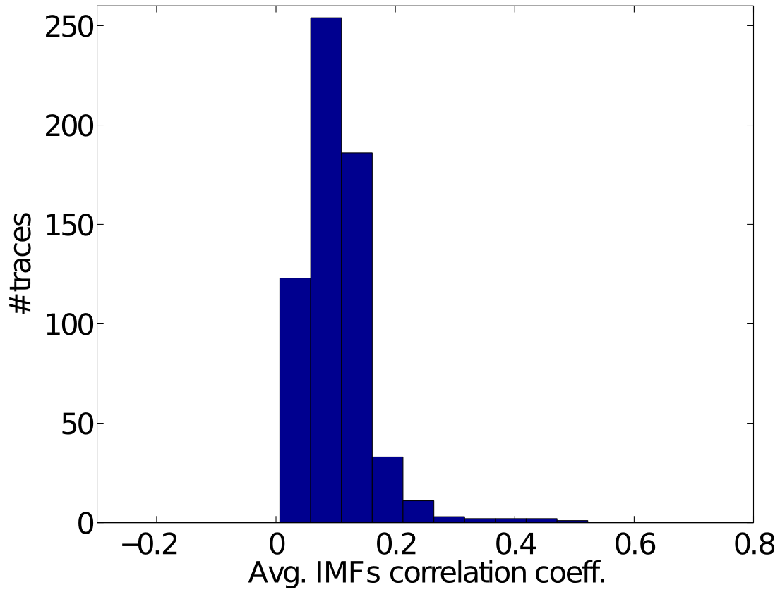
Broader validation
Run across 674 sensors
Geometric Verification Promising
Many sensors intrinsically unrelated,
Few related
Notes:
EMD helps us to discriminate un/related sensors

Slide 35
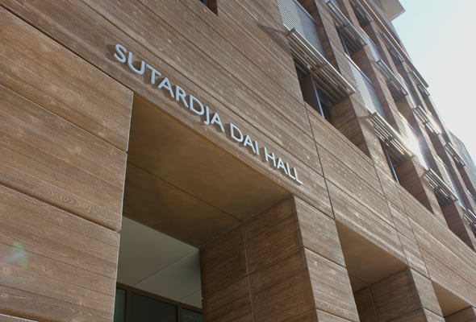
Data set
5 rooms, 3 sensors/room
Sensor type: temperature, humidity, CO₂
Over a one-month period

Slide 36
Results
Clustering results (MDS + k-means)
-MDS: Multidimensional Scaling
On corrcoef from re-aggr.
12/15 correct = 80%
On corrcoef from raw traces
8/15 correct = 53.3%

Slide 37
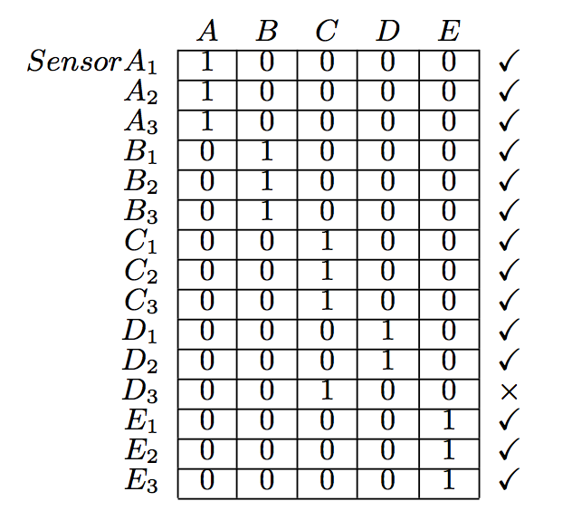
Results
Clustering results (thresholding based)
14/15 correct = 93.3%
*A-B-C-D-E is used to denote the ground truth location of sensors
Notes:
A-B-C-D-E denotes the ground truth -- where each sensor is

Slide 38
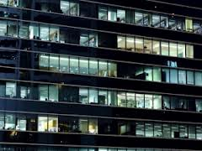
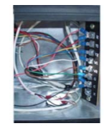
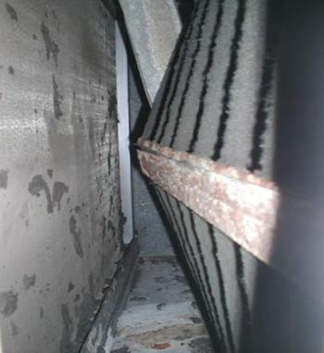
Waste in Buildings
Lights/HVAC left on
Dirty Filter
Exhaust fan hard-wired
Always “on”

Slide 39

Retro-commissioning
Notes:
Top 3 are nearly 70% of all energy loss related to faults (lights and hvac left on is 40%).

Slide 40
Design Goals
Scalable
Any building, any data source, everywhere
Simple tuning
Range-based accuracy
Identify segment in data to focus on and search around
Tradeoff accuracy for scalability

Slide 41
Expanded w/Anomaly Detection
Learn typical correlations patterns
Discover changes
Return associated change points in trace

Slide 42

Experimental Setting
UC Berkeley
Cory Hall
5-story building
Built in 1950
70 sensors stream dataset
Lighting, HVAC, elevator, electrical receptacles and panels, etc.
15 different HVAC systems
8 weeks in Spring 2011

Slide 43


Results
High power usage
Alarms corresponding to electricity waste
Lower power usage
Alarms representing abnormal low electricity consumption
Punctual
Short increase/decrease in electricity consumption
Missing data
Possible sensor failure
Other
unknown
Notes:
b is a constant usually set to 1.4826 for consistency with signma parameter for a Gaussian distribution

Slide 44

Alarms in Eng. Bldg 2 @Todai
AC On All Night
Lights On All Night
AC Not On During
Office Hours

Slide 45

Alarms in Cory Hall
Possible Chiller dysfunction
Change in power usage pattern
Normal
Simultaneous heating and cooling
18 days, 2500 kWh

Slide 46








Deployments
Count | Value
No. of deployments | 7
No. of feeds and files | ~10k
Locations | University of Tokyo, UCB Cory Hall, UCB SDH, Stanford Y2E2, Intel, Nokia, Samsung
Amount of data | ~1TB (2 years)

Slide 47
Future Work
Automate verification further
Examine value and spatial verification
More sophisticated control applications
MPC applications on building
Version control over StreamFS
Provenance checking for streams, jobs, and control settings
Notes:
Implement MPC on building deployment
Combine mobile computing with HCI
Metadata still a problem there, annotations, provenance, sharing
Constantly more data available
Increased noise-floor, picking signal is more challenging
SSDs and GPUs at core
What are the fundamental bottlenecks for different classes of massive distributed measurements?
Suppress some of the noise at the source
Power-prohibitive to suppress it all at the edges

Slide 48
Conclusion
Device drivers
Standard Interfaces
File system
common namespace
Verification
statistical
Physical
Applications
Cloud
FS
Verification
Device Drivers
Sensors

Slide 49
Extra

Slide 50
Re-aggregation
Make seemingly similar/distinct traces distinct/similar
Band for Use!
temperature from two rooms
humidity/temperature in one room
*Correlation coefficient between traces are marked as coef in a box
Notes:
The mid-frequency bin can be used to identify the sensors in the same/different location(s)

Slide 51
Data set
5 rooms, 3 sensors/room
Sensor type: temperature, humidity, CO₂
Over a one-month period

Slide 52
Results
Distribution generation
CDF
In the same room
In different rooms!
correlation coefficient
correlation coefficient
Notes:
For each room, compute the pairwise corrcoefs over different time spans, and accumulate to get two distributions for the two population, aka, intra and inter
An arbitrary cut-off threshold will split the distribution: the part on the right of the threshold will be considered as in the “same” room, likewise, the part on the left of the line will be clustered as in different rooms.

Slide 53
Results
Receiver Operating Characteristic
On the mid IMF band
On the raw traces
Set the 0.2 FPR point as boundary threshold for each room.
TPR: 52%~93%, FPR: 5%~59%

Slide 54
Results
Convergence over time
Convergence of the threshold parameter for different rooms is critical to generalizability.

Slide 55
Results
Clustering results (thresholding based)
14/15 correct = 93.3%
*A-B-C-D-E is used to denote the ground truth location of sensors
Notes:
A-B-C-D-E denotes the ground truth -- where each sensor is

Slide 56
Results
Clustering results (MDS + k-means)
-MDS: Multidimensional Scaling
On corrcoef from re-aggr.
12/15 correct = 80%
On corrcoef from raw traces
8/15 correct = 53.3%

Slide 57
EMD Process
Notes:
Back up - the process of EMD

Slide 64
EMD & IMF Basics

Slide 65
EMD & IMF Basics
IMF:
Equal # of extrema and zero-crossings
Extrema symmetric to zero

Slide 67
Conclusion
Device drivers
File system
Plug-n-play
User
Applications
Kernel
FS
PnP
Device Drivers
Hardware
Notes:
> Standard interface and access methods for retrieving and writing data to external devices.
>

Slide 68
From Sensor Networks to OS
Sensing and Control for Efficient Buildings at Scale
“Strip, Bind, and Search: A Method for Identifying Abnormal Energy Consumption in Buildings”, IPSN 2013
“Towards Real-time, Fine-grained Energy Analytics in Buildings Through Mobile Phones”, Buildsys 2012
“Enabling Green Building Applications”, HotEmNets 2010
“Multichannel Reliability Assessment in Real World WSNs.” IPSN 2010
“Beacon Location Service: A Location Service for Point-to-Point Routing in Wireless Sensor Networks”, IPSN 2007
Building OS
Sensor Networks
Notes:
Strip, Bind, and Search: A Method for Identifying Abnormal Energy Consumption in Buildings IPSN 2013
Towards Real-time, Fine-grained Energy Analytics in Buildings Through Mobile Phones Buildsys 2012
Empirical Mode Decomposition for Intrinsic-Relationship Extraction in Large Sensor Deployments. IoT-App 2012
Enabling Green Building Applications HotEmnets 2010

Slide 69
Alarms in Eng. Bldg 2 @Todai
AC On All Night
Lights On All Night
AC Not On During
Office Hours

Slide 71
Pipes through pub/sub
[ Simplify]
Regular expression topic matching
Thermostats in all the zones
Content-based filtering
Plug-load data in 410 that belongs to Jorge
Path existence topic matching
All the vents that feed 410 from chiller 1
sub.topic(“/cs/zone/*/therm*”);
sub.topic(“/cs/zone*/room/410/*”).
includes(“type”,”plug-load”).
includes(“owner”,”Jorge”);
sub.topic(“/cs/zone*/vent*”).
includes(“name”, “410”).includes(“type”,”vent”).
ancestor(graph.getNode(“/cs/hvac/chiller1”));
Notes:
How come this didn’t work using the first two things?
What are the cute algorithmic things you did you scale this?

Slide 72
Verification
[ Update ]
Inter-relationships manually specified
Relationships
Geometric observation same local activity
Functional measurement type
Semantic application specific relationships (i.e. ownership)
Can we use the sensor data to determine
geometric relationships?

Slide 73



Applications
Mobile application for energy auditing
Data and building configuration viewers
Statistical analysis application in Matlab

Slide 74
Driver Library
calls | Description
create | Join the system as a data source
push | Push data to the system
label | Add an attribute-value pair
rlabel | Remove an attribute-value pair
callbacks | Description
ctrlRcv | Function that handles the reception of control data
remove | Informs the device it is being removed
suspend | Tells the device to stop sending data
resume | Tell the device to resume sending data
Notes:
Library support using protobufs

Slide 75
File/FS API
calls | Description
read | Read the file
write | Write to the file
remove | Delete a file
link | Symlink the file
create | Create new container, proc

Slide 77

Acquisition and Interpretation Loop
UI developed from building schematics
Trend data exported
Data accessible via files/protocol --naming convention
Names interpreted in combination with UI
Data
File name: SODA4R520__ART
Bacnet Point Name: SDH.S1-01:CTL STPT

Slide 78

Trends
100 billion uniquely identifiable objects will be connected to the internet
How do we make sense of all this information?
SSD prices falling

Slide 79
Big Data for Scientists
Big Data tools for scientists
Metadata still a problem there, annotations, provenance, sharing
Constantly more data available
Increased noise-floor, picking signal is more challenging
SSDs and GPUs at core
What are the fundamental bottlenecks for different classes of massive distributed measurements?
Suppress some of the noise at the source
Power-prohibitive to suppress it all at the edges
Leveraging crowdsourcing systems + mobile sensing
[ draft ]

Slide 80
Empirical Mode Decomposition
Stoppage criterion: is based on the number
called the S-number, which is defined as the
number of consecutive siftings when the
numbers of zero-crossings and extrema are
equal or at most differing by one. Specifically,
an S-number is pre-selected. The sifting process
will stop only if for S consecutive times the numbers
of zero-crossings and extrema stay the same, and
are equal or at most differ by one.
Stop when r_{n} is monotonic

Slide 81
Context-related queries
/soda/floor4/*?ts_low=123&ts_high=456
/soda
/soda/floor4/pow
/soda/floor4/420/pow
/soda/floor4/410/vav1/pow
/soda/hvac/Fan1/vav1/pow
/hvac
/floor4
/Chiller
/Fan1
/410
/pow
/420
/pow
/vav1
/pow
/soda/floor4/410/vav1/ → /soda/hvac/Fan1/vav1
Notes:
The query root is a r-node.

Slide 82
Acquisition and Interpretation Loop
UI developed from building schematics
Trend data exported
Data accessible via files/protocol --naming convention
Names interpreted in combination with UI
Data
File name: SODA4R520__ART
Bacnet Point Name: SDH.S1-01:CTL STPT

Slide 83
Shortcomings
No framework to access metadata
Embedded in UI, file/point names
Ad-hoc acquisition of contextual information acquisition
Missing type descriptions, location information
No way of dealing with changes in the environment
The building changes, sensors are replaced/updated, no way to deal with mobility
No solution scales
Every building has it’s own naming conventions, layout, formats

Slide 84

Local filesystem mount of sensor deployment
FUSE driver
Integrating all data in single namespace
IEEE1888/FIAP data source, sMAP data sources, personal energy meters, motion sensors, weather, etc.
1. Write query to local file
2. Read and copy the file with results
3. Import it to local app

Slide 85
Pipes through pub/sub
Regular expression topic matching
Thermostats in all the zones
Content-based filtering
Plug-load data in 410 that belongs to Jorge
Path existence topic matching
All the vents that feed 410 from chiller 1
sub.topic(“/cs/zone/*/therm*”);
sub.topic(“/cs/zone*/room/410/*”).
includes(“type”,”plug-load”).
includes(“owner”,”Jorge”);
sub.topic(“/cs/zone*/vent*”).
includes(“name”, “410”).includes(“type”,”vent”).
ancestor(graph.getNode(“/cs/hvac/chiller1”));
Notes:
How come this didn’t work using the first two things?
What are the cute algorithmic things you did you scale this?

Slide 86
Future Work
Automate spatial verification further
Examine functional and semantic verification
Big Data tools for infrastructure scientists
100 billion uniquely addressable devices by 2020
How do we collect, organize, track and
process this information at scale?
Notes:
Implement MPC on building deployment
Combine mobile computing with HCI
Metadata still a problem there, annotations, provenance, sharing
Constantly more data available
Increased noise-floor, picking signal is more challenging
SSDs and GPUs at core
What are the fundamental bottlenecks for different classes of massive distributed measurements?
Suppress some of the noise at the source
Power-prohibitive to suppress it all at the edges

Slide 87
Models Depend on Geometry
L total load
C*ΔT = u + P_{d} + (T_{oa} – T)/R
C thermal capacitance
T temperature in the space
u heating/cooling power input
P_{d} occupant/computer load
T_{oa} outside air temperature
R is the resistivity of the walls
* * *
V_{t} vents served
u=V_{s}/V_{t} * L – ε_{L}
New space added
V_{s} changes per space
V_{s} vents in
space
V_{s} # of vents in space
V_{t} total # of vents fed by chiller/heater
L load into space
ε_{L} loss
How can we automatically discover
changes made to the physical layout?
Notes:
C*ΔT = u + P_{d} + (T_{oa} – T)/R
C is the thermal capacitance
T is the temperature in the space
u is the amount of heating/cooling power input
U>0 (heating)
U<0 (cooling)
P_{d} is the external disturbance load generated by occupants, direct sunlight, and electrical devices
T_{oa} is the outside air temperature (outside the immediate space, adjacent to the walls)
R is the resistivity of the walls for that space
Typical MPC based on this model
Minimize total heating and cooling energy consumption
Minimize peak power draw
Maintain zones within desired comfort range (despite predicted changes in load)
We know the heating and cooling sensors (on off/state, and the size of the equipment)
We input the zones it feeds through the vents
So we can approximate the input load to the a fraction of the output – a loss constant
u=V_{s}/V_{t} * L – ε_{L}
How many vents are fed by the HVAC system from the central HVAC system?
What fraction of them on in the space?
What’s the current load output of the system? Is it heating or cooling? (L>0 heating, L<0 cooling)
What happens if the space changes?

Slide 88
Empirical mode decomposition
Approach used for finding de-trending signals
Algorithm for decomposing signals in the time domain of non-stationary, non-linear signals
Similar to FFT, PCA but yields characteristic time and frequency scales
Output “Intrinsic mode functions”
Combination of underlying signal in the same time scale
Notes:
in PCA the distribution in eigenvalues do not yield characteristic time or frequency scales

Slide 89

Querying
GET
/SDH/spaces/*?query=true&props_metertype=powermeter
/inventory/mote123
{
“metertype”:”powermeter”,
“desc”:”Electric power meter”,
“timestamp”: 1290500046
}
/power
/par
/hum
/temp
GET
?query=true&ts_timestamp=gt:now-100,ls=now
SID₁
SID₂
SID₃
SID₄
DB
Time

Slide 90
Applications
Mobile application for energy auditing
Data and building configuration viewers
Statistical analysis application in Matlab

Slide 91
Related Work
Using intelligent data analysis to detect abnormal energy consumption in buildings; John Seem, Johnson Controls [1]
Uses electrical feeds to find anomalous electrical signatures
Methods for Fault Detection, Diagnostics, and Prognostics for Building Systems [2]
100+ papers surveyed
HVAC and Refrigeration
Air handling units
Compressors, pumps
Ventilation
Site-specific model and/or complex parameter tuning
Integration & tuning overhead limits scalability

Slide 92
Design Goals
Scalable
Any building, any data source, everywhere
Simple tuning
Range-based accuracy
Identify segment in data to focus on and search around
Tradeoff accuracy for scalability

Slide 93
Goal: System Properties
Extensibility
Component swapping/sharing, ease of expansion
Generalizability
Support for diverse analytics/control applications
Scalability
Should support thousands of streams
Ease of Management
Should be manageable from one place

Slide 94
Alternate Approaches
DB
Ids to identify object (uniform id space)
Metadata & data storage
No direct sensor/actuator access
Point name: SDH.S1-01:CTL STPT
No history
No metadata
Not easily extendable

Slide 95




Searching for Outliers
Construct reference matrix for each time-reference interval
For new data points, compute l
Identifying outliers
Median Absolute Deviation
p=4
, b=1.4826

Slide 96
Properties
Extensibility
Streams from BACNet, sMAP, FIAP, shared jobs
Generalizability
Viewers, mobile application, processing
Scalability
Web services architecture
Ease of Management
Everything is a file

Slide 97
Applications
Data and building configuration viewers
Statistical analysis application in Matlab

